Slide 1
INTERPOLATION Prof. Samuel Okolie, Prof. Yinka Adekunle & Dr. Seun Ebiesuwa

Slide 2
In many areas of science, we are often given a set of discrete values of a function either in the form of a table of values or a set of experimental measurements which actually represent a set of points along a continous function.
Given these discrete values, we wish to find intermediate values.
If the given values of the function are reasonably exact (eg, as may be given in a trigonometric table) the process of finding intermediate values is called interpolation.

Slide 3
If, on other hand the given values are not very accurate (eg. If they come from actual measurements) then we need to perform a different process called CURVE FITTING which tries to average out some of the errors.
Polynomial interpolation is thus the most common method used to estimate values between precise data points.
Examples of interpolation
Look at the problem of finding the sine of 6.5 degree. Let us assume that we are given a table of sines where the values are given for steps of one degree. If we have the task of finding sin 6.5⁰, we have 3 options

Slide 4
Use a Taylors series to calculate the sine to as much accuracy as we deserve
Note: [ sin x = x - x³/3! + x⁵/5! – x⁷/7! + x⁹/9! ……]
Use a book of tables which lists the sines in smaller steps of perhaps 0.5 or 0.1 degree and look up the exact value.
Use the sines for 6 and 7 degrees given in the available table, try to interpolate for the value of 6.5
The above example illustrates common characteristics of interpolation problems.

Slide 5
We usually know exactly what function we are considering and probably even have an exact equation which could be used to find the exact answer (eg. sine (x) from Taylor’s series).
We may for some reason prefer to use table look-up. But if the available table does not include all the desired values of the argument or if the table having all the values of the desired information is too large to fit into the computer memory, we have to use interpolation along with a less detailed table.
We are starting with a set of tabulated points which are presumably correct to some desired accuracy.

Slide 6
CURVE FITTING
In curve fitting, we may not have such a set of exact points available, eg.
While testing an automobile for its acceleration the car is started from a halt, on a level road, and driven at max acceleration until its speed reaches 60miles/hr. At the same time, speedometer readings are made at 1 second intervals. When the speed is plotted as a function of time we have a set of points as below:

Slide 7
POLYNOMIAL INTERPOLATION
The general formula for nth order polynomial is:
For n+1 data points there is one and only one polynomial of order n that passes through all the points
e.g, there is only one straight line (i.e, a first order polynomial) that connects two points.
Similarly only one parabola connects a set of 3 points (2nd order, quadratic or parabolic mean the same thing).
Only one third order (cubic ) polynomial can connect 4 points

Slide 8
Polynomial Interpolation consist of determining the unique n^{th} – order polynomial that fits (n+1) data points.
The Polynomial then provides a formula to compute intermediate values.

Slide 9
Linear Interpolation
The simplest form of interpolation is to connect two data points with a straight line, as depicted graphically below. (see Fig 2.1).
Linear interpolation is the process where we approximate a small portion of a curve with a straight line which passes through 2 known points of the curve for accuracy we choose the two points as close to the desired points as possible.

Slide 10
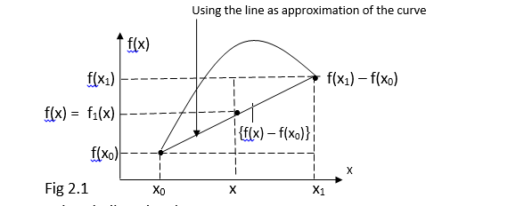

Slide 11
In general the smaller the interval between the data points, the better the approximation.

Slide 16
f₂(x) = 0 + 0.4620981 (x – 1) - 0.0518731(x-1)(x – 4)
therefore: At x= 2
f₂(2) = 0.5658443
this represents a relative error of 18.4%
this the curvature introduced by the quadratic formula improves the interpolation compared with result obtained using straight line.

Slide 17
